Slide 1
Quality Assurance of Software and Information Systems
Dr. Amira Mohey El-Din

Slide 2
What is Quality?
Quality Management System
What is Quality Assurance?
What is Quality Control?

Slide 3
Defining Quality
Customers:
The software you create lives up to expectations, is reliable, and easy to use and learn.
Development team:
The work is completed as planned and as expected with acceptable performance, with few errors — and fewer surprises.
Managers:
The customer is happy and the project delivers on time and on budget and acceptable resource usage.
Maintenance team:
The simplicity and modularity of the system, The documentation produced by the developers; and The ease of understanding the implementation.

Slide 4
Quality Management System
procedures required for planning and execution (production/development/service) in the core business area of an organization (i.e., areas that can impact the organization's ability to meet customer requirements).

Slide 5
Quality Assurance
Quality Assurance Methods for ensuring that information systems are free from errors and fraud and provide information products of high quality.
It is the Degree to which a system meets specified requirements and customer expectations. It is also monitoring the processes and products throughout the SDLC.

Slide 6
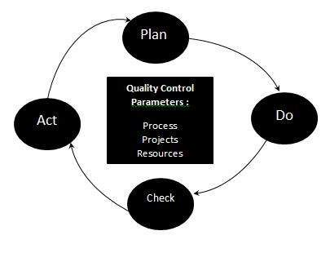
What is Quality Control?
Quality control is a set of methods used by organizations to achieve quality parameters or quality goals and continually improve the organization's ability to ensure that a software product will meet quality goals.
The three class parameters that control software quality are:
Products
Processes
Resources
The quality control process consists of:
Plan - It is the stage where the Quality control processes are planned
Do - Use a defined parameter to develop the quality
Check - Stage to verify if the quality of the parameters are met
Act - Take corrective action if needed and repeat the work
Notes:
These above steps are repeated to ensure that processes followed in the organization are evaluated and improved on a periodic basis. Let's look into the above steps in detail -
Plan - Organization should plan and establish the process related objectives and determine the processes that are required to deliver a high-Quality end product.
Do - Development and testing of Processes and also "do" changes in the processes
Check - Monitoring of processes, modify the processes, and check whether it meets the predetermined objectives
Act - Implement actions that are necessary to achieve improvements in the processes
An organization must use Quality Assurance to ensure that the product is designed and implemented with correct procedures. This helps reduce problems and errors, in the final product.

Slide 7
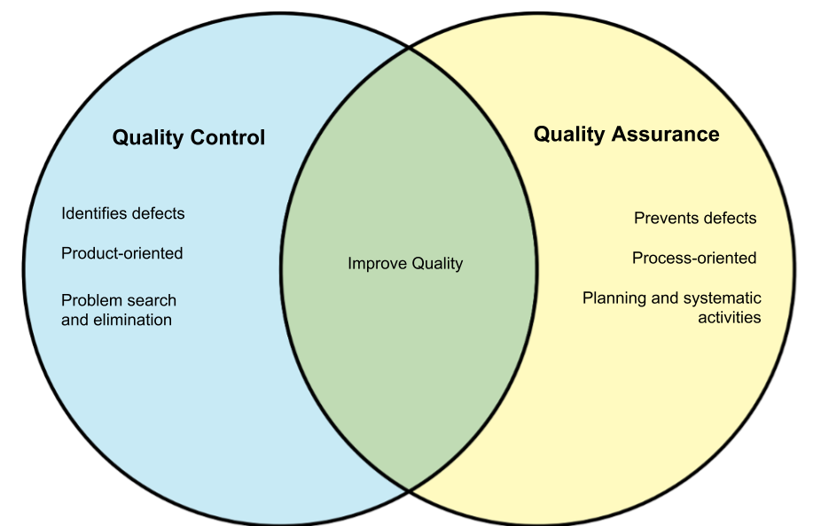
QA & QC
Notes:
What is Quality Control?
Quality control popularly abbreviated as QC. It is a Software Engineering process used to ensure quality in a product or a service. It does not deal with the processes used to create a product; rather it examines the quality of the "end products" and the final outcome.
The main aim of Quality control is to check whether the products meet the specifications and requirements of the customer. If an issue or problem is identified, it needs to be fixed before delivery to the customer.
QC also evaluates people on their quality level skill sets and imparts training and certifications. This evaluation is required for the service based organization and helps provide "perfect" service to the customers.

Slide 8
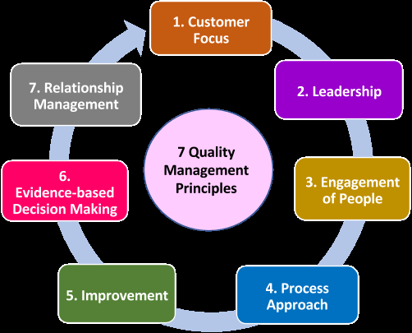
Quality Principles

Slide 9
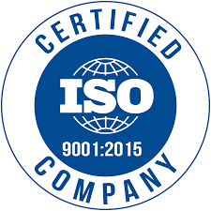
Quality Assurance Certifications: 1. IOS 9001
This certification helps -
Increase the profit of the organization
Improves Domestic and International trade
Reduces waste and increase the productivity of the employees
Provide Excellent customer satisfaction
Notes:
This standard was first established in 1987, and it is related to Quality Management Systems. This helps the organization ensure quality to their customers and other stakeholders. An organization who wishes to be certified as ISO 9000 is audited based on their functions, products, services and their processes. The main objective is to review and verify whether the organization is following the process as expected and check whether existing processes need improvement.

Slide 10
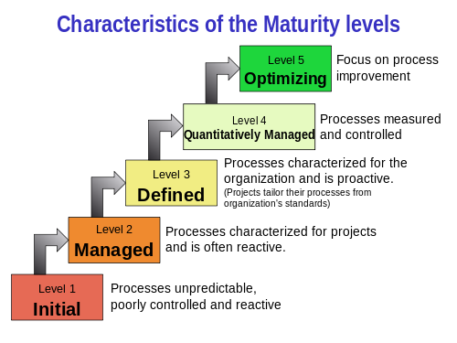
2 - CMMI level (Capability Maturity Model Integrated)
Notes:
i) Initial The software processes at this level are ad hoc and do not give a stable environment.
The success of project depends on the capability and braveness of the people in the organization.
There are no actual applications required to adopt planning, monitoring or controlling the process.
It is not possible to estimate the time and cost to develop the software.
ii) Repeatable The software development processes are repeatable. They are not repeated for all the projects in the organization.
An organization may use basic and constant project management processes to track cost, schedule and functionality.
The minimum process discipline is used to repeat earlier success of project with same applications.
iii) Defined In defined level of maturity model, common engineering and management activities are standardized and documented.
These standards are adapted and accepted for use on various projects.
Test documents and plans are reviewed and accepted before testing starts.
The groups of testers are independent from the developers.
The test outputs are used to determine when the software is ready.
iv) Managed In managed level of maturity, detailed measure of the software process and product quality is gathered.
The software process and product are quantitatively understood and controlled.
v) Optimizing This level show continuous improvement from previous levels and hence it is called as Optimizing.
The processes and new technologies are attempted, the outputs are measured and the evolutionary and incremental changes are achieved for better quality levels.
CMMI level
The Capability Maturity Model Integrated (CMMI) is a process improvement approach developed specially for software process improvement. It is based on the process maturity framework and used as a general aid in business processes in the Software Industry. This model is highly regarded and widely used in Software Development Organizations.
CMMI has 5 levels. An organization is certified at CMMI level 1 to 5 based on the maturity of their Quality Assurance Mechanisms.
Level 1 - Initial: In this stage the quality environment is unstable. Simply, no processes have been followed or documented
Level 2 - Repeatable: Some processes are followed which are repeatable. This level ensures processes are followed at the project level.
Level 3 - Defined: Set of processes are defined and documented at the organizational level. Those defined processes are subject to some degree of improvement.
Level 4 - Managed: This level uses process metrics and effectively controls the processes that are followed.
Level 5 - Optimizing: This level focuses on the continuous improvements of the processes through learning & innovation.

Slide 11
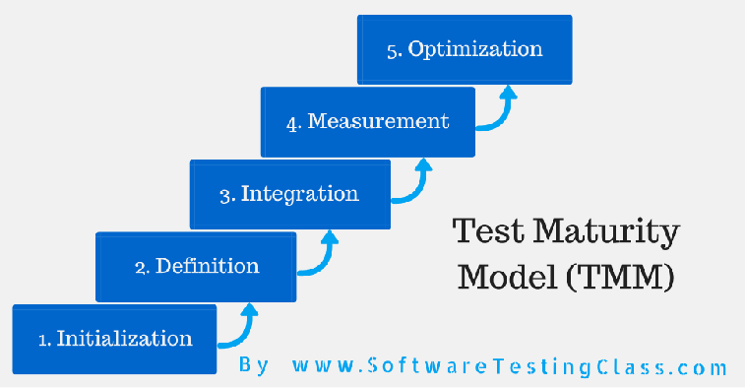
3 - Test Maturity Model (TMM):
Notes:
Test Maturity Model (TMM):
This model assesses the maturity of processes in a Testing Environment. Even this model has 5 levels, defined below-
Level 1 - Initial: There is no quality standard followed for testing processes and only ad-hoc methods are used at this level
Level 2 - Definition: Defined process. Preparation of test strategy, plans, test cases are done.
Level 3 - Integration: Testing is carried out throughout the software development lifecycle (SDLC) - which is nothing but integration with the development activities, E.g., V- Model.
Level 4 - Management and Measurement: Review of requirements and designs takes place at this level and criteria has been set for each level of testing
Level 5 - Optimization: Many preventive techniques are used for testing processes, and tool support(Automation) is used to improve the testing standards and processes.

Slide 12
Software Quality Attribute
1. Functionality
2. Reliability
3. Usability
4. Efficiency
5. Maintainability
6. Portability
Notes:
1. Functionality
Quality of software is defined as how effectively the software interacts with other components of the system. The software must provide appropriate functions as per requirement, and these functions must be implemented correctly.
2. Reliability
It is defined as the capability of the software to perform under specific conditions for a specified duration.
3. Usability
Usability of software is defined as its ease of use. Quality of the software is also identified as how easily a user can understand the functions of the software and how much efforts are required to follow the features.
4. Efficiency
The efficiency of the software is dependent on the architecture and coding practice followed during development.
5. Maintainability
Maintainability is also one of the significant factors to define the quality of the software. It refers to identify the fault and fix in the software. It should be stable when the changes are made.
6. Portability
Portability of the software, defined as how easily a system adapts to changes in the specifications. Quality of the software is also determined by the portability of the system how easy it is to install the software and how easy it is to replace a component of the order in a given environment.
To ensure about a software score well on these quality attribute, we need the following software Quality Assurance.

Slide 13
Software testing
Software testing is a planned process that is used to identify the correctness, completeness, security and quality of software.
– Testing is generally done to demonstrate that the software is doing what it is supposed to do as well as the software is not doing what it is not supposed to do.
– The goal of testing or software tester is to locate defects and make sure that they get fixed.

Slide 14
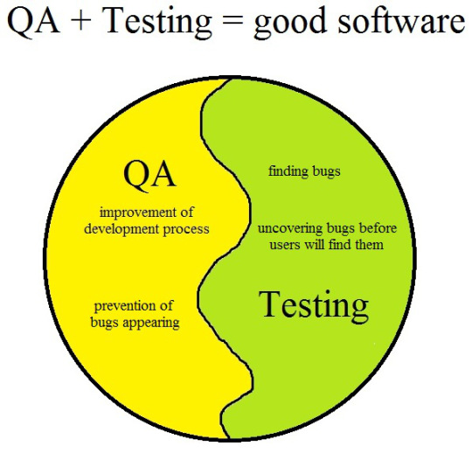
Testing & QA

Slide 15


Error - Fault - Failure
A person makes
an error ...
… that creates a fault in the software ...
… that can cause a failure in operation

Slide 16
Error - Fault - Failure
Software development process
software error
software fault
software failure
Failure is an event; fault is a state of
the software, caused by an error

Slide 17
VV&T
Verification
The process of evaluating a system or component to determine whether the products of the given development phase satisfy the conditions imposed at the start of that phase
Ex: Building the product correctly
Validation
Determination of the correctness of the products of software development with respect to the user needs and requirements
Building the correct product
Testing
The process of exercising software to verify that it satisfies specified requirements and to detect faults

Slide 18
THANK YOU

